Slide 1
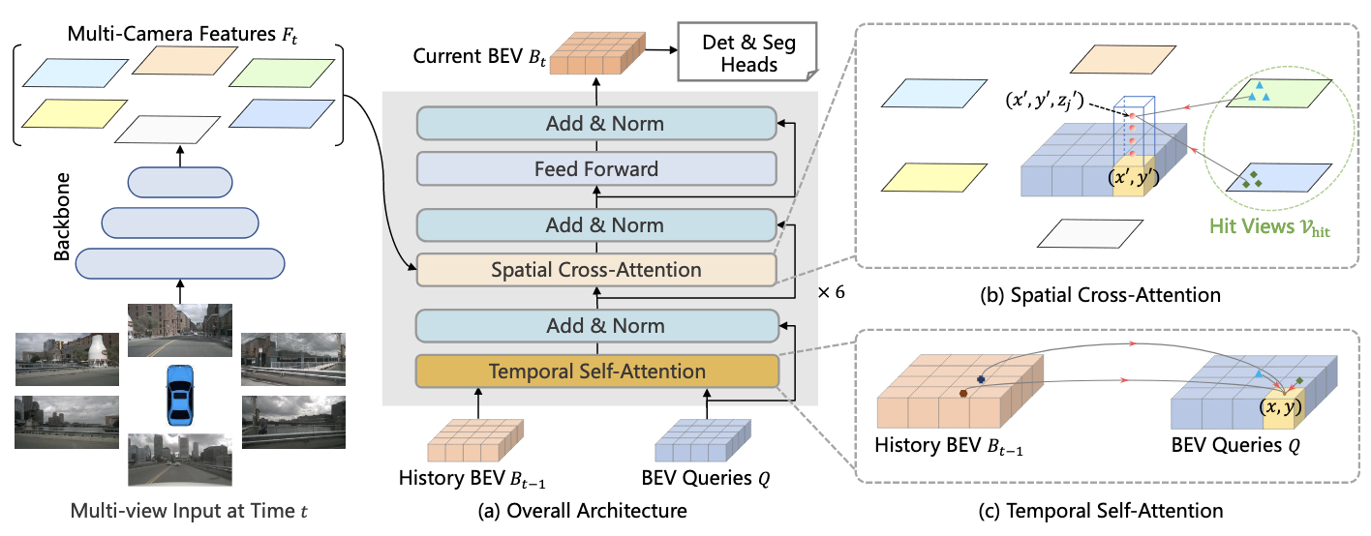




















$$⋯$$
$$⋯$$
$$⋯$$
$$⋯$$
$$⋮$$
$$⋱$$
$$⋰$$
$$⋮$$
$$⋮$$
$$⋱$$
$$⋰$$
$$⋮$$
$$⋮$$
$$⋰$$
$$⋱$$
$$⋮$$
$$⋮$$
$$⋰$$
$$⋱$$
$$⋮$$
$$⋯$$
$$⋯$$
$$⋯$$
$$⋯$$

Slide 2
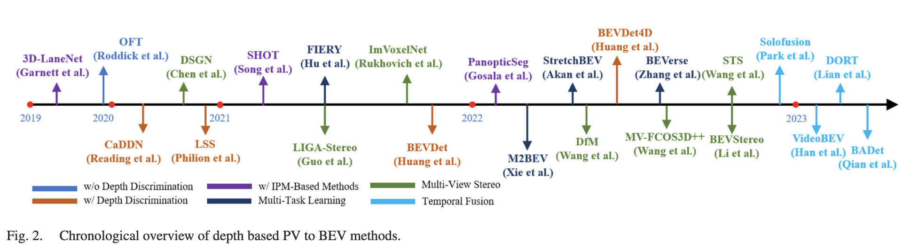
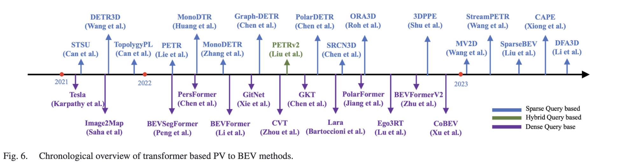
Relationship
LSS (Philion et al.)
BEVDet (Huang et al.)
BEVFormer (Li et al.)

Slide 3
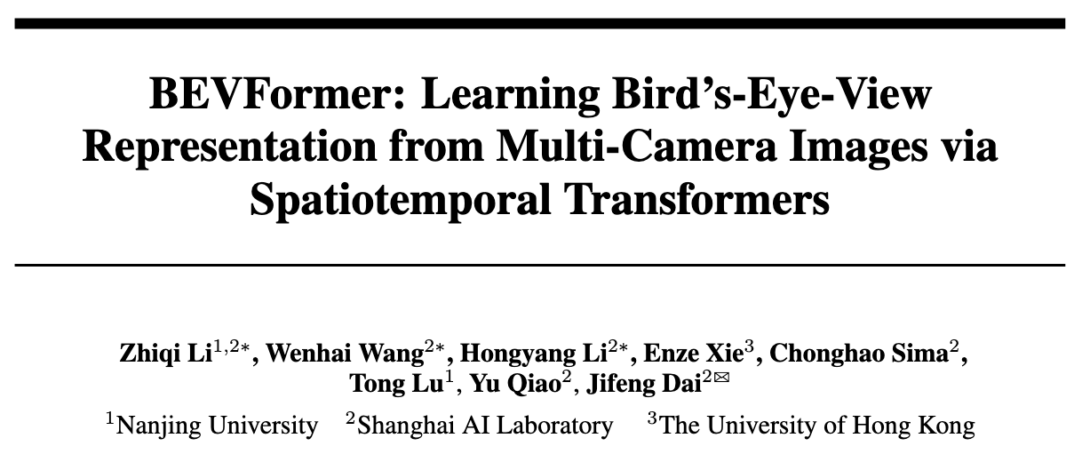
ECCV 2022
세미나 발표자 : 김형균 (PseudoLab 10th)

Slide 4
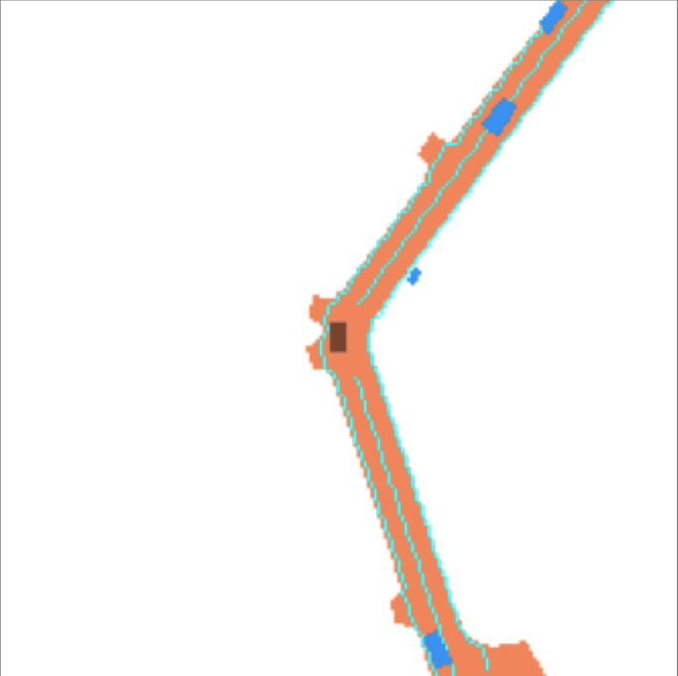
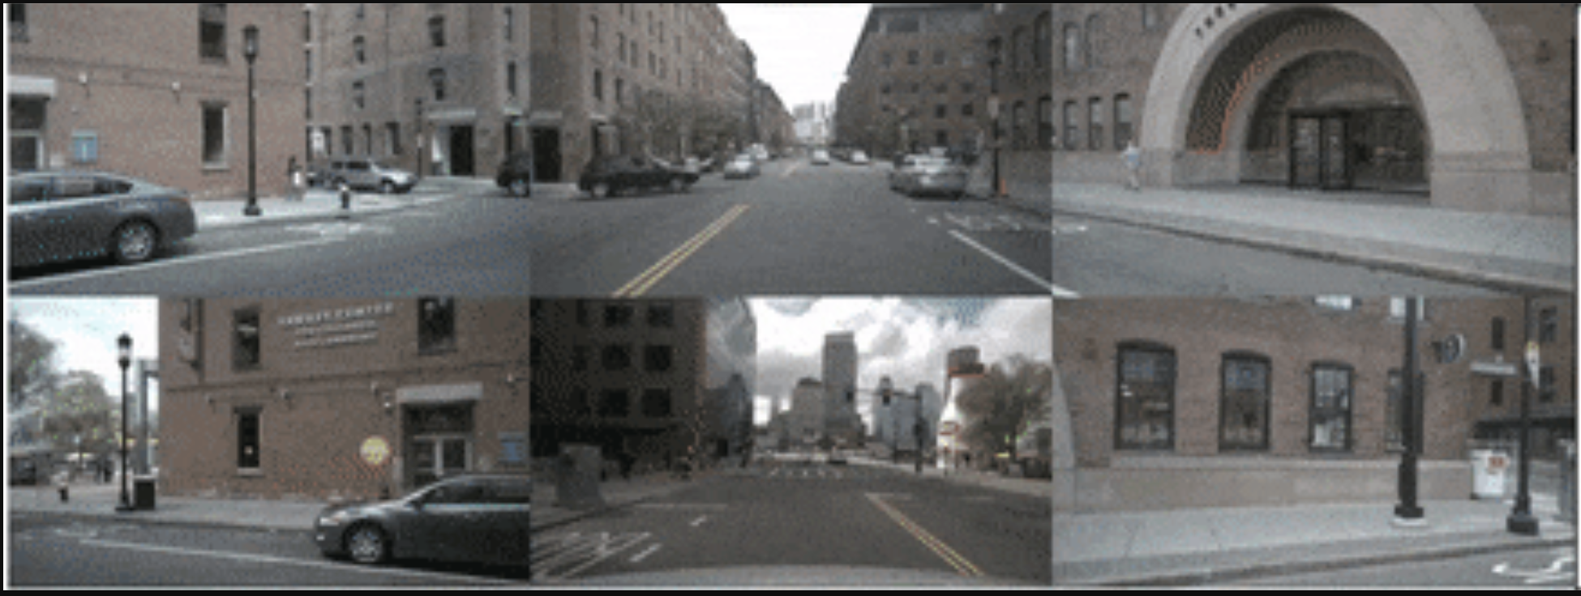
Relationship
Bottom-Up (2D → 3D)
LSS (Philion et al.)
2020-08
BEVDet (Huang et al.)
2022-06
BEVDepth (Yinhao et al.)
2022-11
BEVFusion (Zhijian et al.)
2024-09
GaussianBeV (Florian et al.)
2024-12
FB-BEV (Zhiqi et al.)
2023-08
2021
2022
BEVFormer (Li et al.)
2022-07
Simple-BEV (Adam et al.)
2022-09
PETRv2 (Liu et al.)
2022-11
2023
2024
PointBeV (Loick et al.)
2024-05
2025
Top-Down (3D → 2D)
Colored : Camera-only
Bold : Attention mechanism
Ref. Ma, Yuexin, et al. "Vision-centric bev perception: A survey." IEEE Transactions on Pattern Analysis and Machine Intelligence (2024).

Slide 5
Agenda
Problem Definition
Methodology: BEVFormer
Experiment Results
Key takeaways

Slide 6
Problem Definition

Slide 7
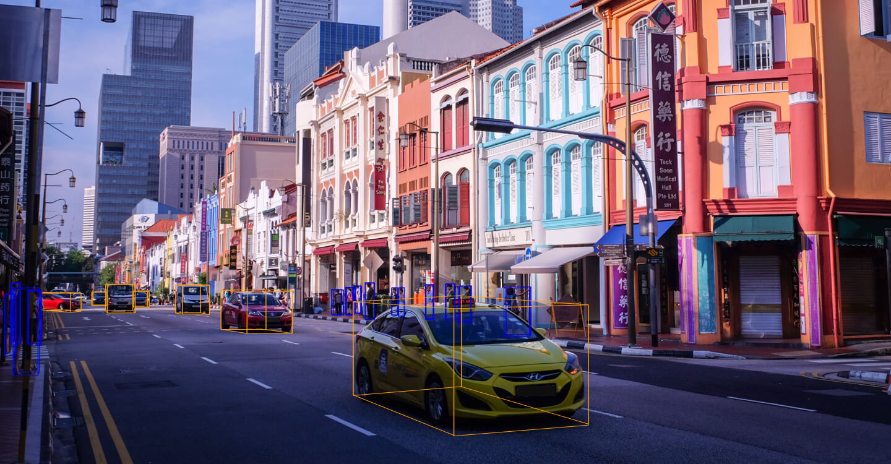
Problem Definition
Multi-Camera 기반 3D Perception: Bird’s-Eye View (BEV) Representation
Lidar 센서에 비해 저렴한 가격
원거리 및 고해상도 정보 습득 가능
주행에 필요한 Vision-based 이미지 감지 가능 (e.g., 주행 신호, 정지선, 횡단보도 등)
Camera-view 이미지를 통한 Object detection 과 Segmentation task
Figure : Caesar, Holger, et al. "nuscenes: A multimodal dataset for autonomous driving." Proceedings of the IEEE/CVF conference on computer vision and pattern recognition. 2020.

Slide 8
Problem Definition
기존의 Multi-Camera BEV Representation Models
Depth Information 기반
e.g., Lift-Splat-Shoot, BEVDet, …
Bottom-Up Method (2D → 3D)
Depth Estimation에서 누적된 오차가 Downstream Task 성능 저하에 큰 영향
Temporal Information 사용 X
Temporal Information의 활용 가능성
움직이는 물체 추적
가려진 물체 추론
물체의 속도 추론

Slide 9
Problem Definition
BEVFormer: Multi-Camera BEV Representation via Spatiotemporal Transformer
Spatial
Cross-Attention
Depth Information 기반
e.g., Lift-Splat-Shoot, BEVDet, and so on
Bottom-Up Method (2D → 3D)
Depth Estimation에서 누적된 오차가 Downstream Task 성능 저하에 큰 영향
Temporal Information 사용 X
Temporal Information의 활용 가능성
움직이는 물체 추적
가려진 물체 추론
물체의 속도 추론

Slide 10
Problem Definition
BEVFormer: Multi-Camera BEV Representation via Spatiotemporal Transformer
Spatial
Cross-Attention
Depth Information 기반
e.g., Lift-Splat-Shoot, BEVDet, and so on
Bottom-Up Method (2D → 3D)
Depth Estimation에서 누적된 오차가 Downstream Task 성능 저하에 큰 영향
Temporal
Self-Attention
Temporal Information 사용 X
Temporal Information의 활용 가능성
움직이는 물체 추적
가려진 물체 추론
물체의 속도 추론

Slide 11
Problem Definition
BEVFormer: Multi-Camera BEV Representation via Spatiotemporal Transformer
Spatial
Cross-Attention
Depth Information 기반
e.g., Lift-Splat-Shoot, BEVDet, and so on
Bottom-Up Method (2D → 3D)
Depth Estimation에서 누적된 오차가 Downstream Task 성능 저하에 큰 영향
Temporal
Self-Attention
Temporal Information 사용 X
Temporal Information의 활용 가능성
움직이는 물체 추적
가려진 물체 추론
물체의 속도 추론
Grid-shaped BEV Queries

Slide 12
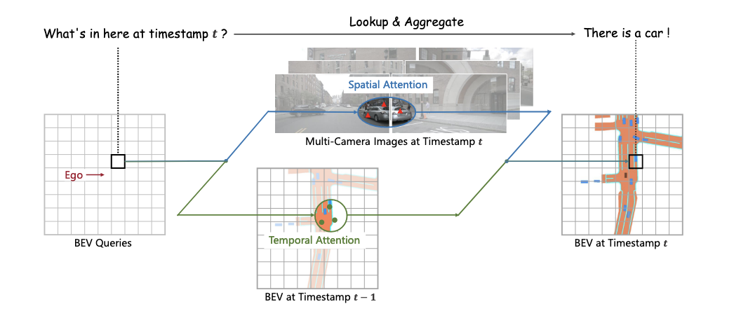
Methodology
BEVFormer: Multi-Camera BEV Representation via Spatiotemporal Transformer

Slide 13
Methodology - BEVFormer
Overview

Slide 14
Methodology - BEVFormer
Overview
Grid-shaped
BEV queries
Temporal
Self-Attention
Spatial
Cross-Attention

Slide 15
Methodology - BEVFormer
Overview
Grid-shaped
BEV queries
Temporal
Self-Attention
Spatial
Cross-Attention

Slide 16
Methodology - BEVFormer
Overview
Grid-shaped
BEV queries
Temporal
Self-Attention
Spatial
Cross-Attention

Slide 17

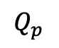
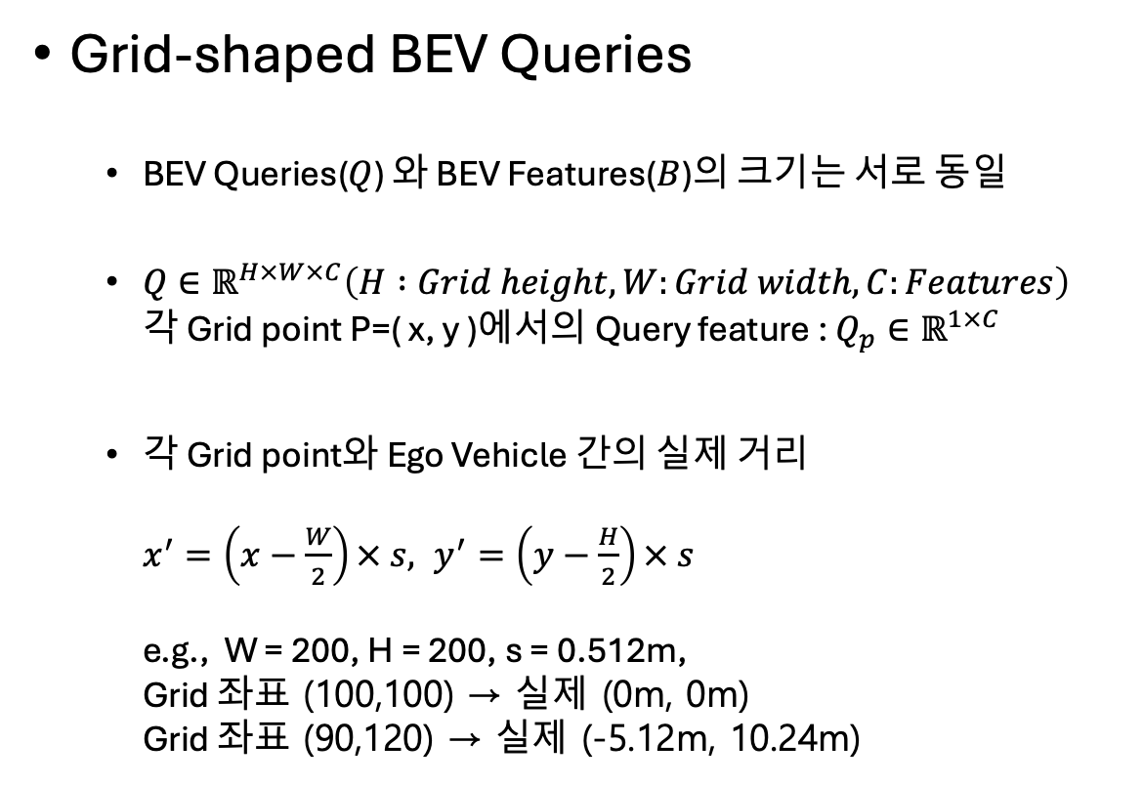
Methodology - BEVFormer
Grid-shaped BEV Queries
BEV Queries($Q$) 와 BEV Features($B$)의 크기는 서로 동일
$Q∈ℝ^{H×W×C}\left(H :Grid height, W:Grid width, C:Features\right)$ 각 Grid point P=( x, y )에서의 Query feature : $Q_{p}∈ℝ^{1×C}$
각 Grid point와 Ego Vehicle 간의 실제 거리 $x^{′}=\left(x−\frac{W}{2}\right)× s, y^{′}=\left(y−\frac{H}{2}\right)× s$ e.g., W = 200, H = 200, s = 0.512m, Grid 좌표 (100,100) → 실제 (0m, 0m) Grid 좌표 (90,120) → 실제 (-5.12m, 10.24m)
BEV Queries / Features
(200, 200)
Ego
(100,100)
(0, 0)
$$Q_{p}$$
$$⋯$$
0
255

Slide 18
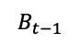
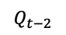
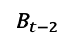
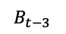
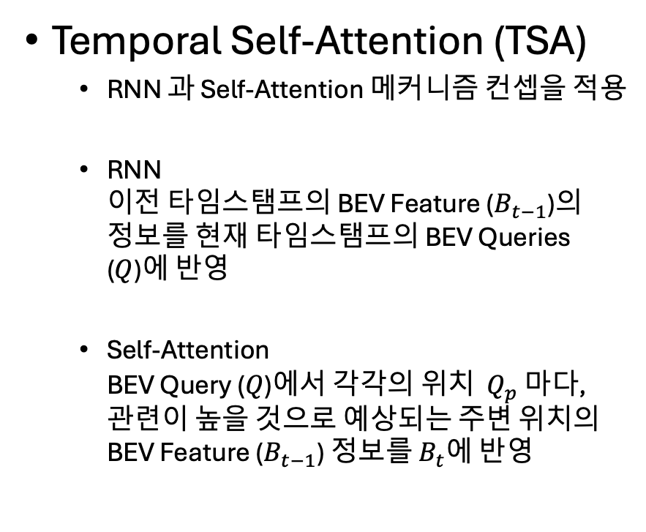
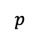
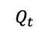
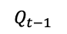
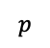
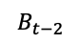
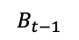
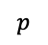
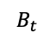
Methodology - BEVFormer
Temporal Self-Attention (TSA)
RNN 과 Self-Attention 메커니즘 컨셉을 적용
RNN 이전 타임스탬프의 BEV Feature ($B_{t−1}$)의 정보를 현재 타임스탬프의 BEV Queries ($Q$)에 반영
Self-Attention BEV Query ($Q$)에서 각각의 위치 $Q_{p}$ 마다, 관련이 높을 것으로 예상되는 주변 위치의 BEV Feature ($B_{t−1}$) 정보를 $B_{t}$에 반영
$$B_{t−2}$$
$$B_{t−1}$$
$$B_{t}$$
BEVFormer
(TSA + …)
$$p$$
$$p$$
$$p$$
$$B_{t−3}$$
$$Q_{t−2}$$
$$B_{t−2}$$
$$Q_{t−1}$$
$$B_{t−1}$$
$$Q_{t}$$
NOTE! Training과 Inference의 효율을 높이기 위해, Deformable DETR(Zhu et al., 2020) [1] 의 Attention 메커니즘을 활용.
[1] Zhu, Xizhou, et al. "Deformable detr: Deformable transformers for end-to-end object detection." arXiv preprint arXiv:2010.04159 (2020).

Slide 19
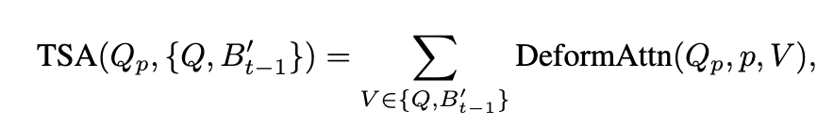
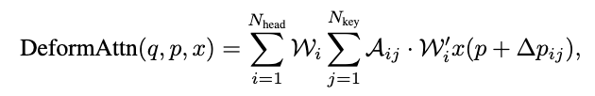
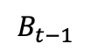
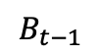
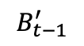
Methodology - BEVFormer
Temporal Self-Attention (TSA) ← Deformable Attention
$$B_{t−1}$$
Ego Vehicle의 움직임 정보를 바탕으로 t-1의 BEV Feature 들의 위치 조정*
$$B_{t−1}$$
$$B_{t−1}^{′}$$
Figure : Zhu, Xizhou, et al. "Deformable detr: Deformable transformers for end-to-end object detection." arXiv preprint arXiv:2010.04159 (2020).
Notes:
Nuscenes 데이터의 각 Scene마다 ego vehicle 의 infos[‘ego2global_translation’], infos[‘ego2global_rotation’]를 사용하여, Bt-1의 Alignment를 진행.
코드 상에서는 can_bus 라는 Key에 이 정보를 저장하여 사용. -> 실제 차량의 CAN 통신 정보와 Matching 하기 위함으로 보임.

Slide 20
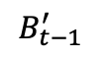
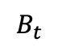
Methodology - BEVFormer
Temporal Self-Attention (TSA) ← Deformable Attention
$$B_{t−1}$$
Ego Vehicle의 움직임 정보를 바탕으로 Feature 들의 위치 조정*
$$B_{t−1}^{′}$$
$$B_{t}$$
?
Figure : Zhu, Xizhou, et al. "Deformable detr: Deformable transformers for end-to-end object detection." arXiv preprint arXiv:2010.04159 (2020).
Notes:
Nuscenes 데이터의 각 Scene마다 ego vehicle 의 infos[‘ego2global_translation’], infos[‘ego2global_rotation’]를 사용하여, Bt-1의 Alignment를 진행.
코드 상에서는 can_bus 라는 Key에 이 정보를 저장하여 사용. -> 실제 차량의 CAN 통신 정보와 Matching 하기 위함으로 보임.

Slide 21
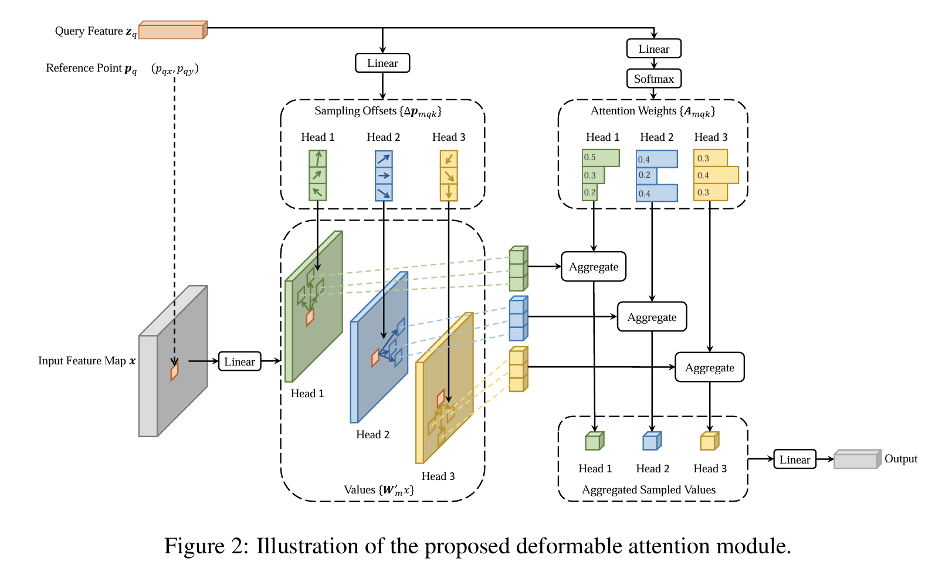
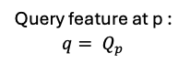
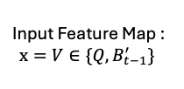
Methodology - BEVFormer
Temporal Self-Attention (TSA) ← Deformable Attention
Query feature at p : ${q= Q}_{p}$
$$B_{t−1}$$
Ego Vehicle의 움직임 정보를 바탕으로 Feature 들의 위치 조정*
Input Feature Map : $x=V∈\{Q, B_{t−1}^{′}\}$
Figure : Zhu, Xizhou, et al. "Deformable detr: Deformable transformers for end-to-end object detection." arXiv preprint arXiv:2010.04159 (2020).

Slide 22

Methodology - BEVFormer
Temporal Self-Attention (TSA) ← Deformable Attention
Query feature at p : ${q= Q}_{p}$
$$B_{t−1}$$
Ego Vehicle의 움직임 정보를 바탕으로 Feature 들의 위치 조정*
Input Feature Map : $x=V∈\{Q, B_{t−1}^{′}\}$
논문에선 $N_{head}=8, N_{key}=4$ 사용
Figure : Zhu, Xizhou, et al. "Deformable detr: Deformable transformers for end-to-end object detection." arXiv preprint arXiv:2010.04159 (2020).
Notes:
논문에서는 8개의 head와 4개의 reference point를 사용 -> 총 32개의 Sampled attention key를사용.

Slide 23
Methodology - BEVFormer
Temporal Self-Attention (TSA) ← Deformable Attention
Query feature at p : ${q= Q}_{p}$
$$B_{t−1}$$
Ego Vehicle의 움직임 정보를 바탕으로 Feature 들의 위치 조정*
Input Feature Map : $x=V∈\{Q, B_{t−1}^{′}\}$
논문에선 $N_{head}=8, N_{key}=4$ 사용
Figure : Zhu, Xizhou, et al. "Deformable detr: Deformable transformers for end-to-end object detection." arXiv preprint arXiv:2010.04159 (2020).

Slide 24
Methodology - BEVFormer
Temporal Self-Attention (TSA) ← Deformable Attention
Query feature at p : ${q= Q}_{p}$
$$B_{t−1}$$
Ego Vehicle의 움직임 정보를 바탕으로 Feature 들의 위치 조정*
Input Feature Map : $x=V∈\{Q, B_{t−1}^{′}\}$
논문에선 $N_{head}=8, N_{key}=4$ 사용
Figure : Zhu, Xizhou, et al. "Deformable detr: Deformable transformers for end-to-end object detection." arXiv preprint arXiv:2010.04159 (2020).

Slide 25
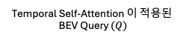
Methodology - BEVFormer
Spatial Cross-Attention (SCA)
Temporal Self-Attention 이 적용된
BEV Query $(Q)$

Slide 26

Methodology - BEVFormer
Spatial Cross-Attention (SCA)
1. Hit Views $𝒱_{hit}$ 선정
Temporal Self-Attention 이 적용된
BEV Query $(Q)$
2. BEV Query와 Multi-Camera Feature 간의 Cross-Attention (Multi-Scale Deformable Attention)

Slide 27
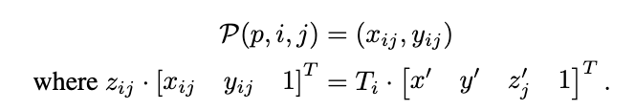
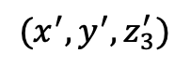
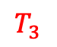



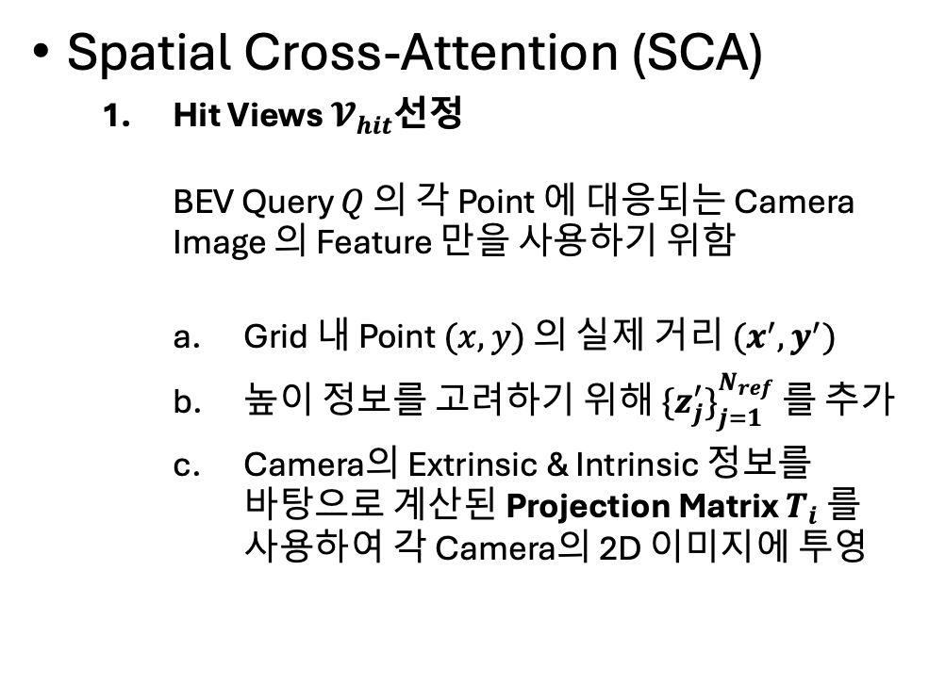
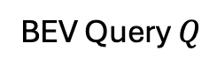
Methodology - BEVFormer
Spatial Cross-Attention (SCA)
Hit Views $𝓥_{hit}$선정 BEV Query $Q$ 의 각 Point 에 대응되는 Camera Image 의 Feature 만을 사용하기 위함
Grid 내 Point $(x,y)$ 의 실제 거리 $(x^{′},y^{′})$
높이 정보를 고려하기 위해 ${\{z_{j}^{′}\}}_{j=1}^{N_{ref}}$ 를 추가
Camera의 Extrinsic & Intrinsic 정보를 바탕으로 계산된 Projection Matrix $T_{i}$ 를 사용하여 각 Camera의 2D 이미지에 투영
cam 1
cam 2
cam 3
$$(x_{13},y_{13})$$
cam 4
cam 5
cam 6
$$(x_{43},y_{43})$$
$$T_{0}$$
$$T_{3}$$
$$(x^{′},y^{′},z_{3}^{′})$$
BEV Query $Q$
Notes:
Nref = 4 (-5m to 3m, but in the code, 0.5m to 7.5m, Double-check)
Projection matrix of cameras ← Nuscenes cams..‘sensor2lidar_translation’ and ‘sensor2lidar_rotation’

Slide 28
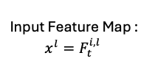
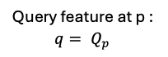
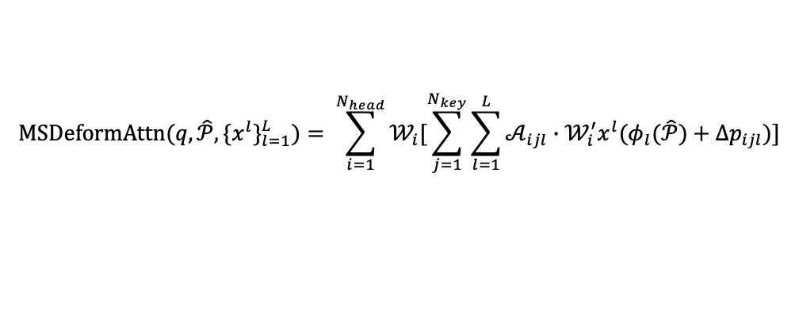
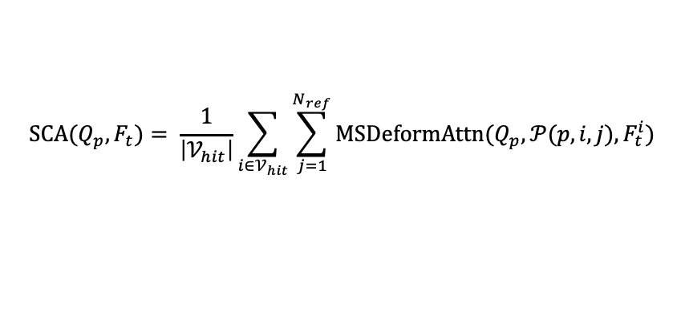
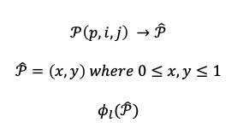
Methodology - BEVFormer
Spatial Cross-Attention (SCA)
BEV Query와 Multi-Camera Feature 간의 Cross-Attention
Query feature at p : ${q= Q}_{p}$
$$\text{SCA}\text{(}Q_{p},F_{t})= \frac{1}{\left|𝒱_{hit}\right|}\sum_{i∈𝒱_{hit}}{\sum_{j=1}^{N_{ref}}{\text{MSDeformAttn}(Q_{p}, 𝒫(p,i,j),F_{t}^{i})}}$$
$$𝒫\left(p,i,j\right) →\hat{𝒫}$$
$$\hat{𝒫}=\left(x,y\right) where 0≤x,y≤1$$
$$φ_{l}(\hat{𝒫})$$
$$\text{MSDeformAttn}\text{(}q,\hat{𝒫}, {\{x^{l}\}}_{l=1}^{L})= \sum_{i=1}^{N_{head}}{𝒲_{i}[\sum_{j=1}^{N_{key}}{\sum_{l=1}^{L}{𝒜_{ijl}∙𝒲_{i}^{′}x^{l}(φ_{l}(\hat{𝒫})+∆p_{ijl})}}]}$$
Input Feature Map : $x^{l}=F_{t}^{i, l}$
Figure : Zhu, Xizhou, et al. "Deformable detr: Deformable transformers for end-to-end object detection." arXiv preprint arXiv:2010.04159 (2020).
Notes:
8 heads, 8 points, 4 level

Slide 29
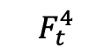
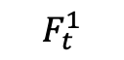
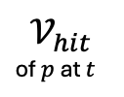
Methodology - BEVFormer
Spatial Cross-Attention (SCA)
BEV Query와 Multi-Camera Feature 간의 Cross-Attention
$$\text{SCA}\text{(}Q_{p},F_{t})= \frac{1}{\left|𝒱_{hit}\right|}\sum_{i∈𝒱_{hit}}{\sum_{j=1}^{N_{ref}}{\text{MSDeformAttn}(Q_{p}, 𝒫(p,i,j),F_{t}^{i})}}$$
$$𝒱_{hit}$$
of $p$ at $t$
$$F_{t}^{1}$$
cam 1
1/16
Backbone Multi-Scale Features e.g., FPN[1]
1/32
l=1
1/64
l=2
l=3
$$F_{t}^{4}$$
1/16
cam 4
1/32
l=1
1/64
l=2
l=3
[1] Lin, Tsung-Yi, et al. "Feature pyramid networks for object detection." Proceedings of the IEEE conference on computer vision and pattern recognition. 2017.
Notes:
8 heads, 8 points, 4 level

Slide 30
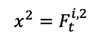
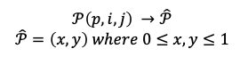

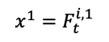




Methodology - BEVFormer
Spatial Cross-Attention (SCA)
BEV Query와 Multi-Camera Feature 간의 Cross-Attention
$$\text{SCA}\text{(}Q_{p},F_{t})= \frac{1}{\left|𝒱_{hit}\right|}\sum_{i∈𝒱_{hit}}{\sum_{j=1}^{N_{ref}}{\text{MSDeformAttn}(Q_{p}, 𝒫(p,i,j),F_{t}^{i})}}$$
$$𝒫(p,i,j)$$
$$\text{MSDeformAttn}\text{(}q,\hat{𝒫}, {\{x^{l}\}}_{l=1}^{L})= \sum_{i=1}^{N_{head}}{𝒲_{i}[\sum_{j=1}^{N_{key}}{\sum_{l=1}^{L}{𝒜_{ijl}∙𝒲_{i}^{′}x^{l}(φ_{l}(\hat{𝒫})+∆p_{ijl})}}]}$$
$$𝒫\left(p,i,j\right) →\hat{𝒫}$$
$$\hat{𝒫}=\left(x,y\right) where 0≤x,y≤1$$
$$φ_{3}(\hat{p})$$
$$x^{1}=F_{t}^{i, 1}$$
$$x^{2}=F_{t}^{i, 2}$$
$$x^{3}=F_{t}^{i, 3}$$
Zhu, Xizhou, et al. "Deformable detr: Deformable transformers for end-to-end object detection." arXiv preprint arXiv:2010.04159 (2020).
Notes:
8 heads, 8 points, 4 level

Slide 31



Methodology - BEVFormer
Spatial Cross-Attention (SCA)
Hit Views $𝓥_{hit}$선정
BEV Query와 Multi-Camera Feature 간의 Cross-Attention
Query feature at p : ${q= Q}_{p}$
$$𝒫\left(p,i,j\right) →\hat{𝒫}$$
$$\hat{𝒫}=\left(x,y\right) where 0≤x,y≤1$$
$$φ_{l}(\hat{𝒫})$$
$$\text{SCA}\text{(}Q_{p},F_{t})= \frac{1}{\left|𝒱_{hit}\right|}\sum_{i∈𝒱_{hit}}{\sum_{j=1}^{N_{ref}}{\text{MSDeformAttn}(Q_{p}, 𝒫(p,i,j),F_{t}^{i})}}$$
$$\text{MSDeformAttn}\text{(}q,\hat{𝒫}, {\{x^{l}\}}_{l=1}^{L})= \sum_{i=1}^{N_{head}}{𝒲_{i}[\sum_{j=1}^{N_{key}}{\sum_{l=1}^{L}{𝒜_{ijl}∙𝒲_{i}^{′}x^{l}(φ_{l}(\hat{𝒫})+∆p_{ijl})}}]}$$
Input Feature Map : $x^{l}=F_{t}^{i, l}$
Figure : Zhu, Xizhou, et al. "Deformable detr: Deformable transformers for end-to-end object detection." arXiv preprint arXiv:2010.04159 (2020).
Notes:
8 heads, 8 points, 4 level

Slide 32
Methodology - BEVFormer
Recap

Slide 33
Experiments

Slide 34




Experiment Setup
Training
Dataset
NuScenes Dataset [1] : 3D OD + Seg
Waymo Open Dataset [2] : 3D OD
Backbone
ResNet101-DCN (FCOS3D [3])
VoVnet-99 (DD3D [4])
Head
3D OD : Deformable DETR [5]
Panoptic SegFormer [6]
Loss Function
3D Object Detection Task : L1 loss
Segmentation Task : Generalized IoU loss
BEVFeature $Q_{t−1}$
BEVFormer
BEVFeature $Q_{t}$
3D Object Detection
Segmentation
[1] Caesar, Holger, et al. "nuscenes: A multimodal dataset for autonomous driving." Proceedings of the IEEE/CVF conference on computer vision and pattern recognition. 2020.
[2] Sun, Pei, et al. "Scalability in perception for autonomous driving: Waymo open dataset." Proceedings of the IEEE/CVF conference on computer vision and pattern recognition. 2020.
[3] Wang, Tai, et al. "Fcos3d: Fully convolutional one-stage monocular 3d object detection." Proceedings of the IEEE/CVF international conference on computer vision. 2021.
[4] Park, Dennis, et al. "Is pseudo-lidar needed for monocular 3d object detection?." Proceedings of the IEEE/CVF International Conference on Computer Vision. 2021.
[5] Zhu, Xizhou, et al. "Deformable detr: Deformable transformers for end-to-end object detection." arXiv preprint arXiv:2010.04159 (2020).
[6] Li, Zhiqi, et al. "Panoptic segformer: Delving deeper into panoptic segmentation with transformers." Proceedings of the IEEE/CVF conference on computer vision and pattern recognition. 2022.

Slide 35

Experiment Results
Camera-only Baseline 모델 (Attention X)에 비해, 9.0 Points 높은 NDS 퍼포먼스와 현저히 줄어든 Velocity 예측 에러를 보여줌.
Lidar 센서를 사용한 Baseline 모델에 준하는 NDS 퍼포먼스를 보여줌.
Notes:
nuScenes detection score (NDS): We consolidate the above metrics by computing a weighted sum: mAP, mATE, mASE, mAOE, mAVE and mAAE.
mean Average Precision (mAP): We use the well-known Average Precision metric, but define a match by considering the 2D center distance on the ground plane rather than intersection over union based affinities.
Average Translation Error (ATE): Euclidean center distance in 2D in meters.
Average Scale Error (ASE): Calculated as 1 - IOU after aligning centers and orientation.
Average Orientation Error (AOE): Smallest yaw angle difference between prediction and ground-truth in radians. Orientation error is evaluated at 360 degree for all classes except barriers where it is only evaluated at 180 degrees. Orientation errors for cones are ignored.
Average Velocity Error (AVE): Absolute velocity error in m/s. Velocity error for barriers and cones are ignored.
Average Attribute Error (AAE): Calculated as 1 - acc, where acc is the attribute classification accuracy. Attribute error for barriers and cones are ignored.

Slide 36

Experiment Results
* BEVFormer-S Spatial Cross-Attention만 적용된 BEVFormer
2D → 3D 기반 Baseline 모델인 VPN과 LSS 보다 전반적으로 향상된 퍼포먼스를 보여줌.
BEVFormer 모델의 Multi-Task Learning 적용 가능성을 확인. (예외, Road and Lane Segmentation)

Slide 37

Experiment Results
BEVFormer는 Object Visibility 가 낮은 (0-40 %) 환경에서도 Robust한 퍼포먼스를 보여줌.
특히, Visibility가 낮은 환경에서, Temporal information이 3D Object의 Translation, Orientation, 그리고 Velocity 예측 에러를 줄이는 데 효과적임을 보여줌.

Slide 38
Key takeaways

Slide 39
Key takeaways
BEVFormer
BEV map의 각 위치에서의 Feature 정보를 Spatiotemporal Attention Mechanism을 활용하여 Multi-camera image로부터 효율적으로 추출
Depth Estimation의 오차로부터 자유로운 Top-Down (3D → 2D) 방식의 방법론.
Camera만 사용하더라도 Lidar 사용 모델과 대등한 수준의 퍼포먼스.

Slide 40
Thanks !

